Slide 1


Slide 2
TABLE OF CONTENTS
OUR TEAM
OUR GOALS
FEATURES

Slide 3
OUR TEAM
1

Slide 4
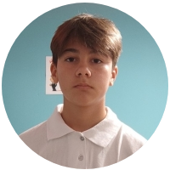
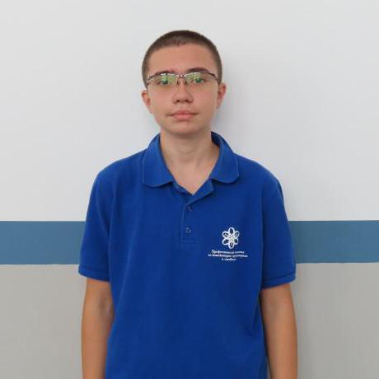

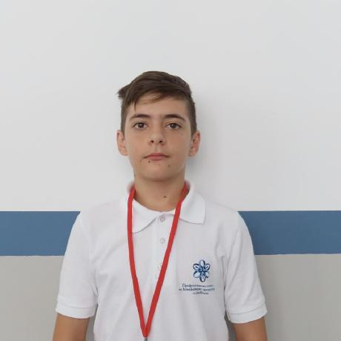
OUR TEAM
PETUR DIMITROV 9G
SCRUM TRAINER

Slide 5
OUR TEAM
PRESIYAN KOLEV 9A
BACK-END DEVELOPER

Slide 6
OUR TEAM
RUMEN SPASOV 9V
FRONT-END DEVELOPER

Slide 7
OUR TEAM
MARTIN YANEV 9B
DESIGNER

Slide 8
OUR GOAL
2

Slide 9
OUR GOAL
Our goal for our project is to help firefighters by providing information regarding their job in real time whilst making it easier for pedestrians to get in touch with them and report fires.

Slide 10
FEATURES
3

Slide 11
FEATURES
Interactive map
Quick and easy report page
Convenient Log in page
Live map of fires

Slide 12
NOW, LETS SHOW THE WEBSITE
THANK YOU FOR YOUR ATTENTION

Slide 13
NOW, LETS SHOW THE WEBSITE
THANK YOU FOR YOUR ATTENTION

